Slide 1
Mas Rapido! Speedy Automated Machine Learning Models with Parallelized Caret
MGSC 410
Prof. Jonathan Hersh

Slide 2
Plan for Today
Who am I?
Data science skills assessment
Parallelizing in R
What is a parallel process?
Why parallelize?
How to do it? R package: doParallel, foreach
Automated Machine Learning Software
R package caret

Slide 3
Analytics Skills scraped from LinkedIn Job Postings
https://twitter.com/tylerburleigh/status/1172920043891503105?s=20

Slide 4
Analytics Skills scraped from LinkedIn Job Postings
https://twitter.com/tylerburleigh/status/1172920043891503105?s=20

Slide 5
https://twitter.com/tylerburleigh/status/1172920043891503105?s=20

Slide 6
Plan for Today
Who am I?
Data science skills assessment
Parallelizing in R
What is a parallel process?
Why parallelize?
How to do it? R package: doParallel, foreach
Automated Machine Learning Software
R package caret

Slide 7
What is parallelization?
The CPU, or central processing unit, is the bit in the computer that actually calculates things.
These are fast
Intel Core i7 7500U ~ 50 billion instructions per second
50,000 MIPS
GFLOPS (1 billion floating points per second)
Floating point = 7 digits (32 bit)
“double” 16 digits (64 bit)

Slide 8
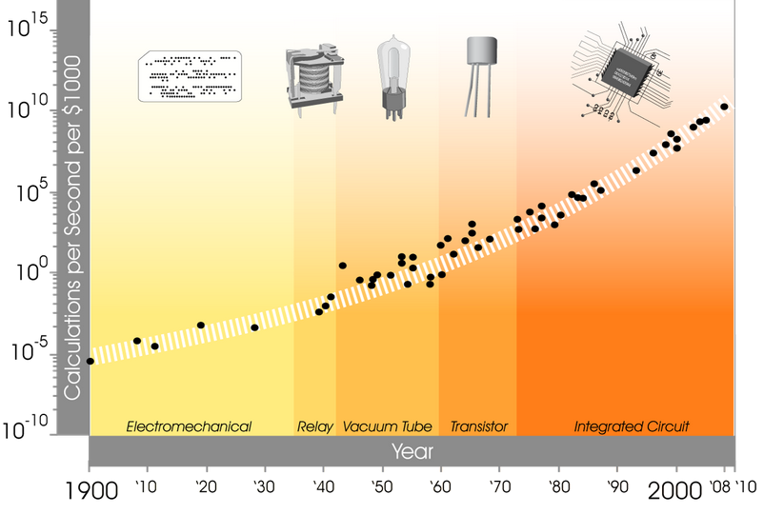
Processor calculation speed over time

Slide 9
What’s the problem?
Deep learning and machine learning often need many more compute cycles to train
Model | Type | Parameters | Model Size (MB) | GFLOPs (forward pass)
ResNet152 | CNN | 60,344,387 | 230MB | 11.3
Training data: 14M images (ImageNet)
FLOPs per pass of data: 3*11.3*10^9 * 14 * 10^6
Training time for 1 epoch 140 TFLOPS (trillion floating points)

Slide 10
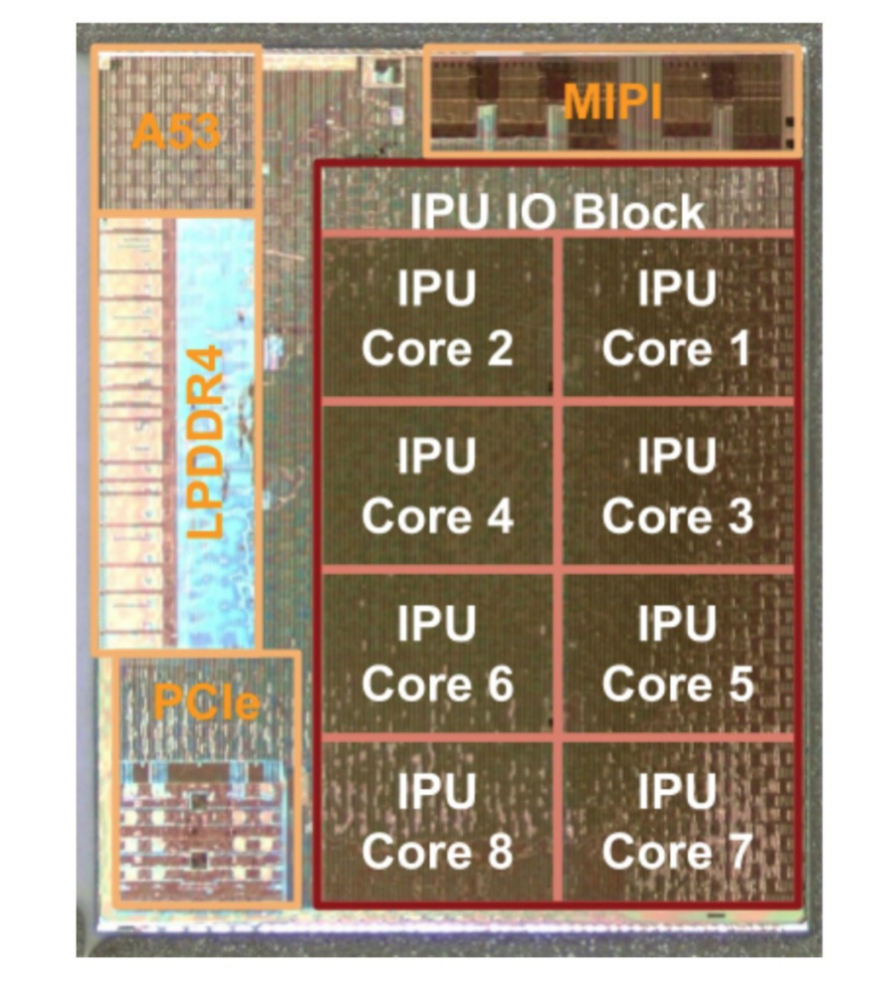
Multiple Cores to the Rescue
Core i7 4770K 4 cores @ 3.5 GHz
182 GFLOPS
45.5 GFLOPS per core
Core i7 5960X: 8 Core @ 3GHz
354 GFLOPS
44.25 per core

Slide 11
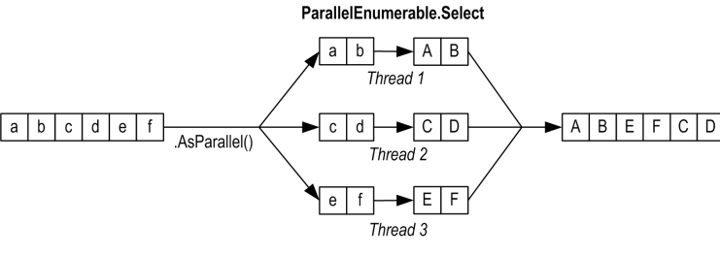
Idea of Parallelization

Slide 12
GPU – Graphics Processor Units

Slide 13
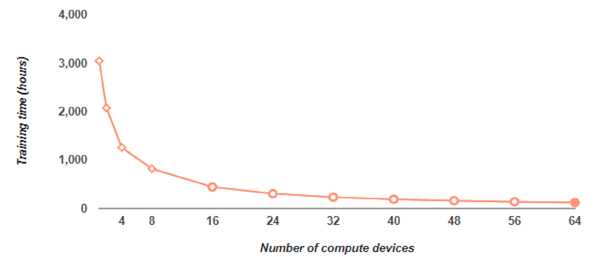
Multiple Cores to the Rescue

Slide 14
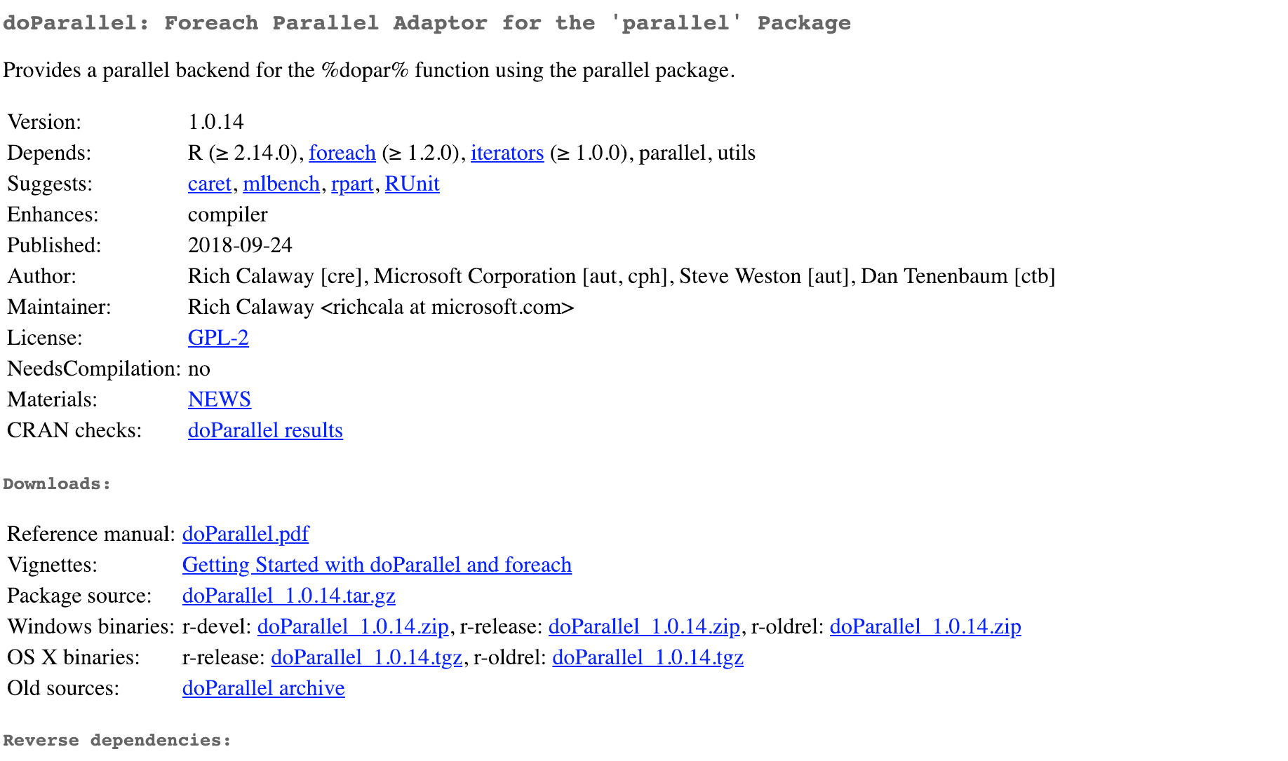
Parallelizing in R w/ doParallel

Slide 15
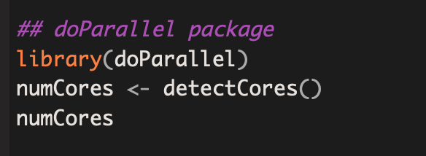
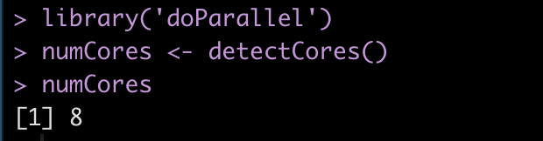
Detecting your cores using detectCores()

Slide 16
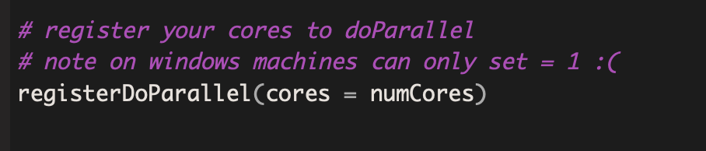
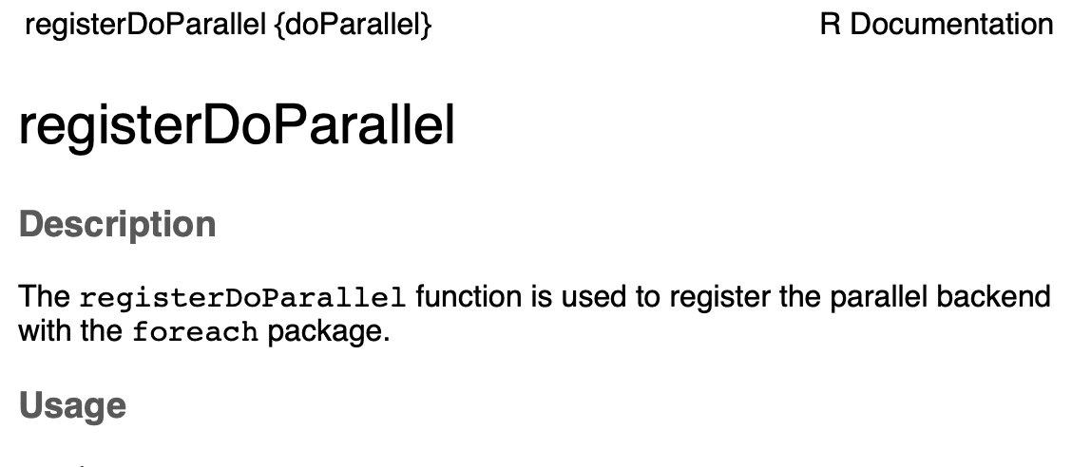
Set number of cores with registerDoParallel()

Slide 17
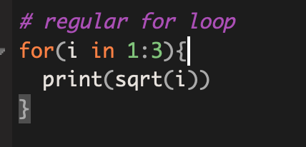
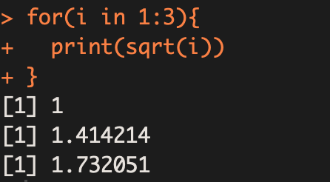
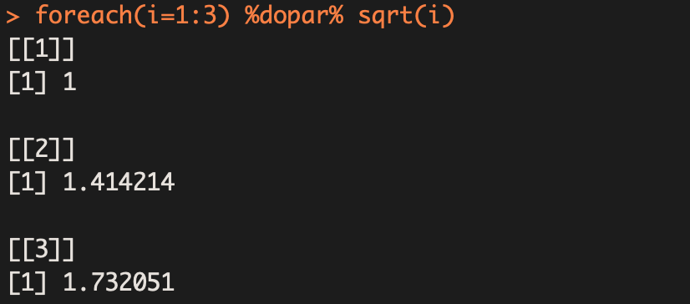
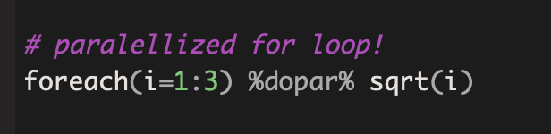
foreach and %dopar% function

Slide 18
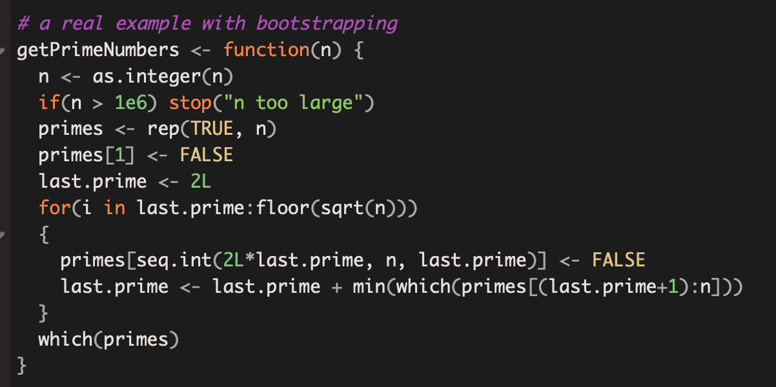
A real example: Let’s Parallelize a Prime Number Finder Function

Slide 19
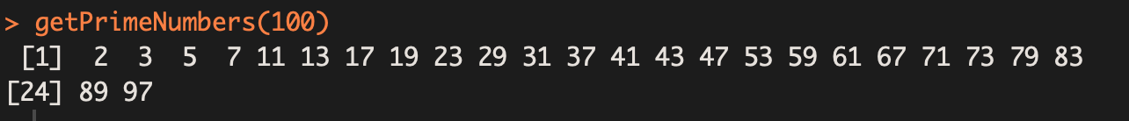
Find primes up to 100

Slide 20
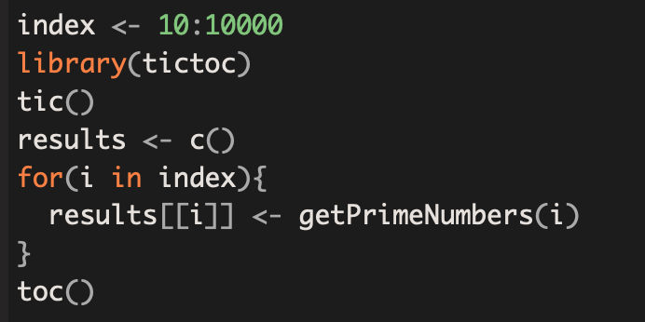
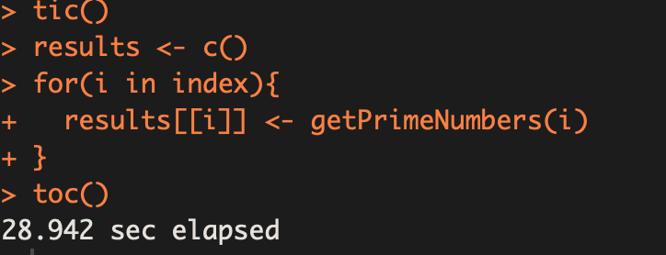
Let’s do this 10,000 times using a boring for loop

Slide 21
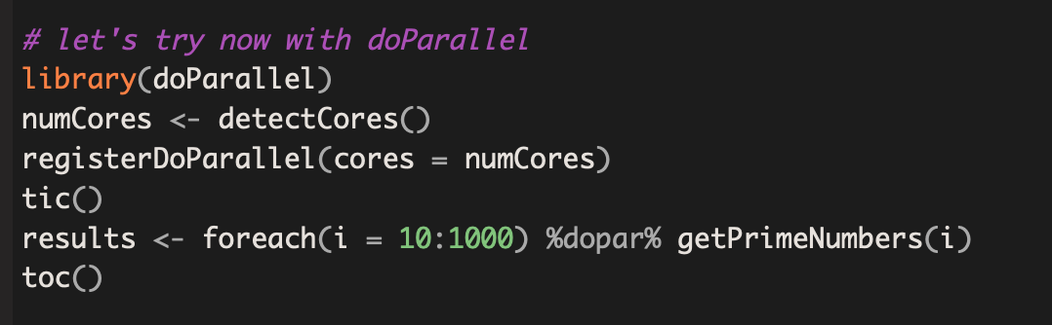
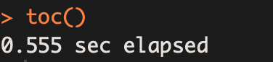
Let’s do this 10,000 times the smart way

Slide 22
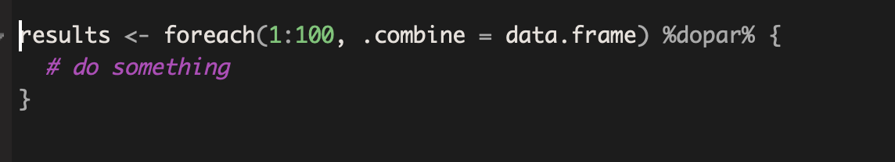
What if we want to store the results from each for loop?

Slide 23
On your own…generate 1000 random numbers of length 1000

Slide 24
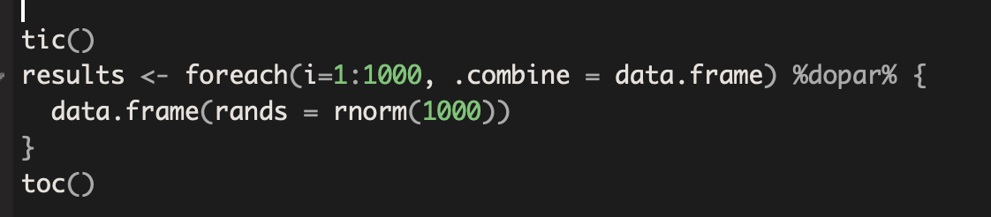
On your own…generate 1000 random numbers of length 1000

Slide 25
Plan for Today
Who am I?
Data science skills assessment
Parallelizing in R
What is a parallel process?
Why parallelize?
How to do it? R package: doParallel, foreach
Automated Machine Learning Software
R package caret

Slide 26
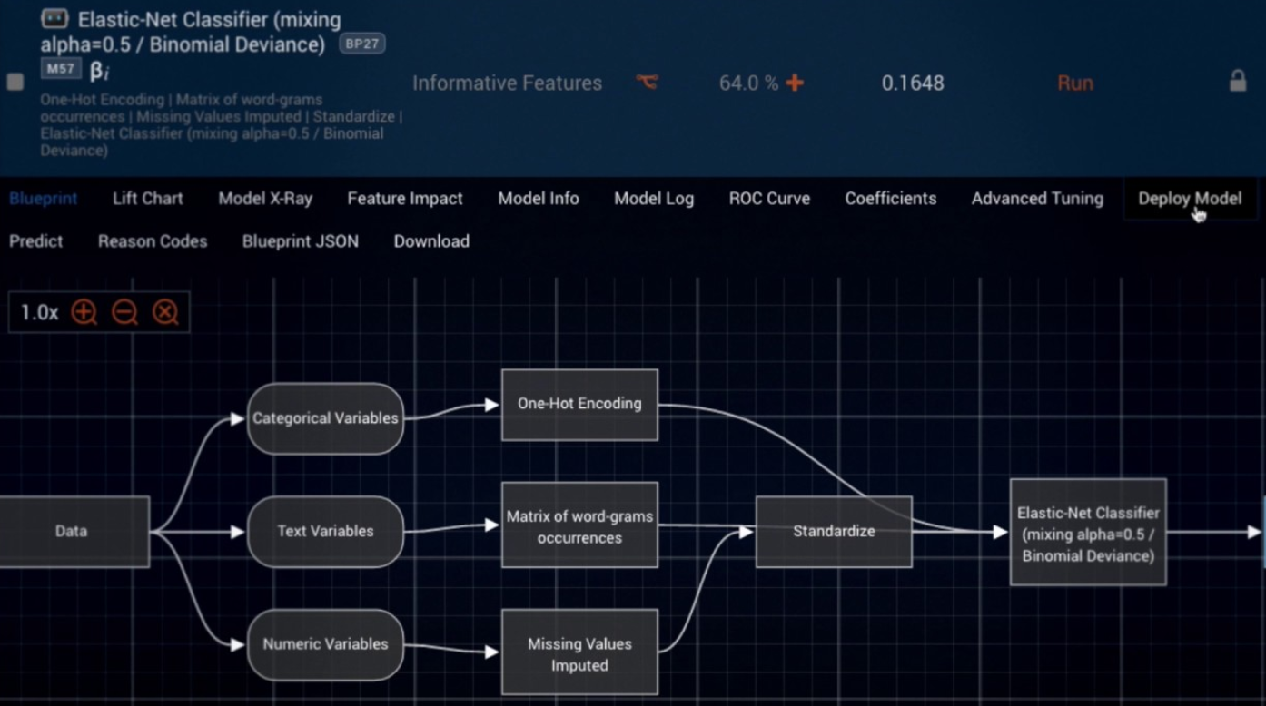
Automated machine learning software: DataRobot

Slide 27
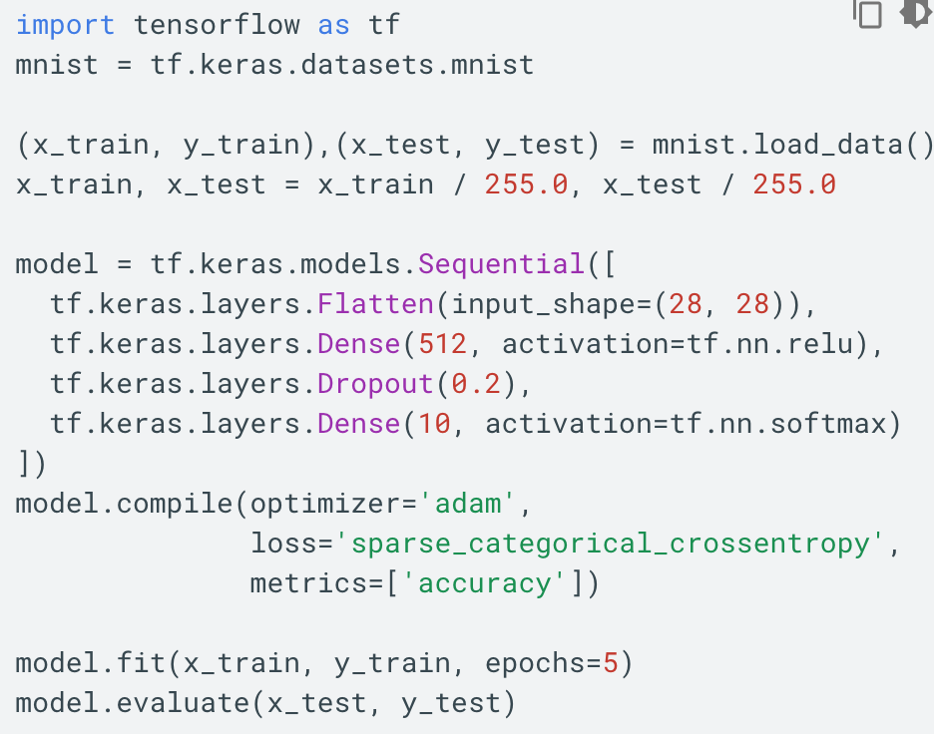
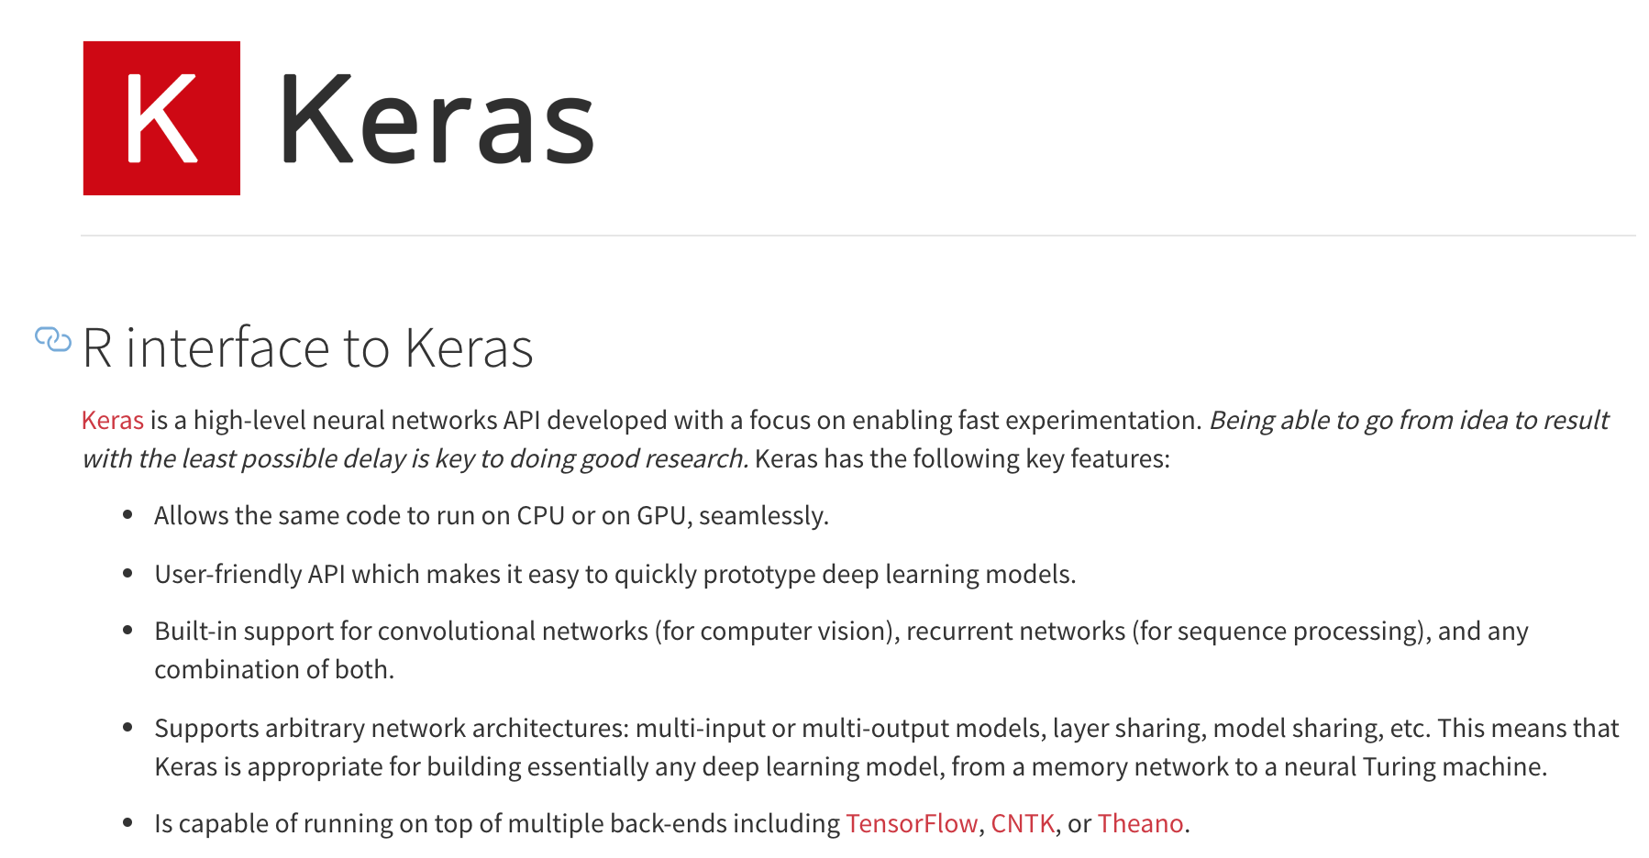
AutoML: TensorFlow & Keras

Slide 28
Auto ML: Azure Studio

Slide 29
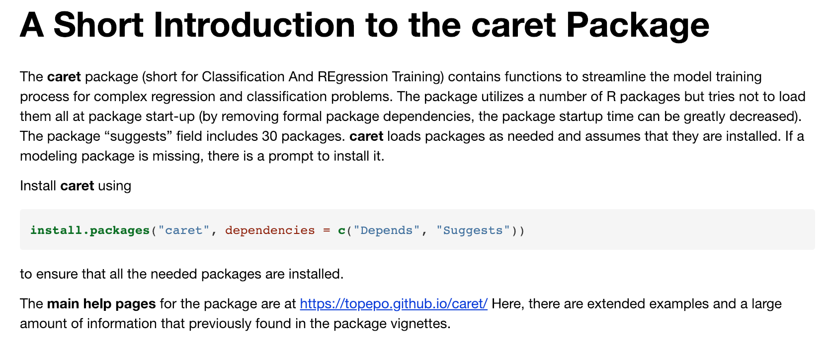

Slide 30

Why caret?
In short, caret streamlines the model building process and
Provides a unified formula interface
Evaluates, using resampling, the effect of model parameters on validation performance
Chooses optimal parameters on OOS performance
HUGE list of models available

Slide 31
Caret Has Tools For
Data Splitting
Data Pre-Processing (center, scaling)
Feature selection
Model tuning and resampling
Variable importance and other post-estimation diagnostics
Comprehensive guide at: https://topepo.github.io/caret/index.html

Slide 32
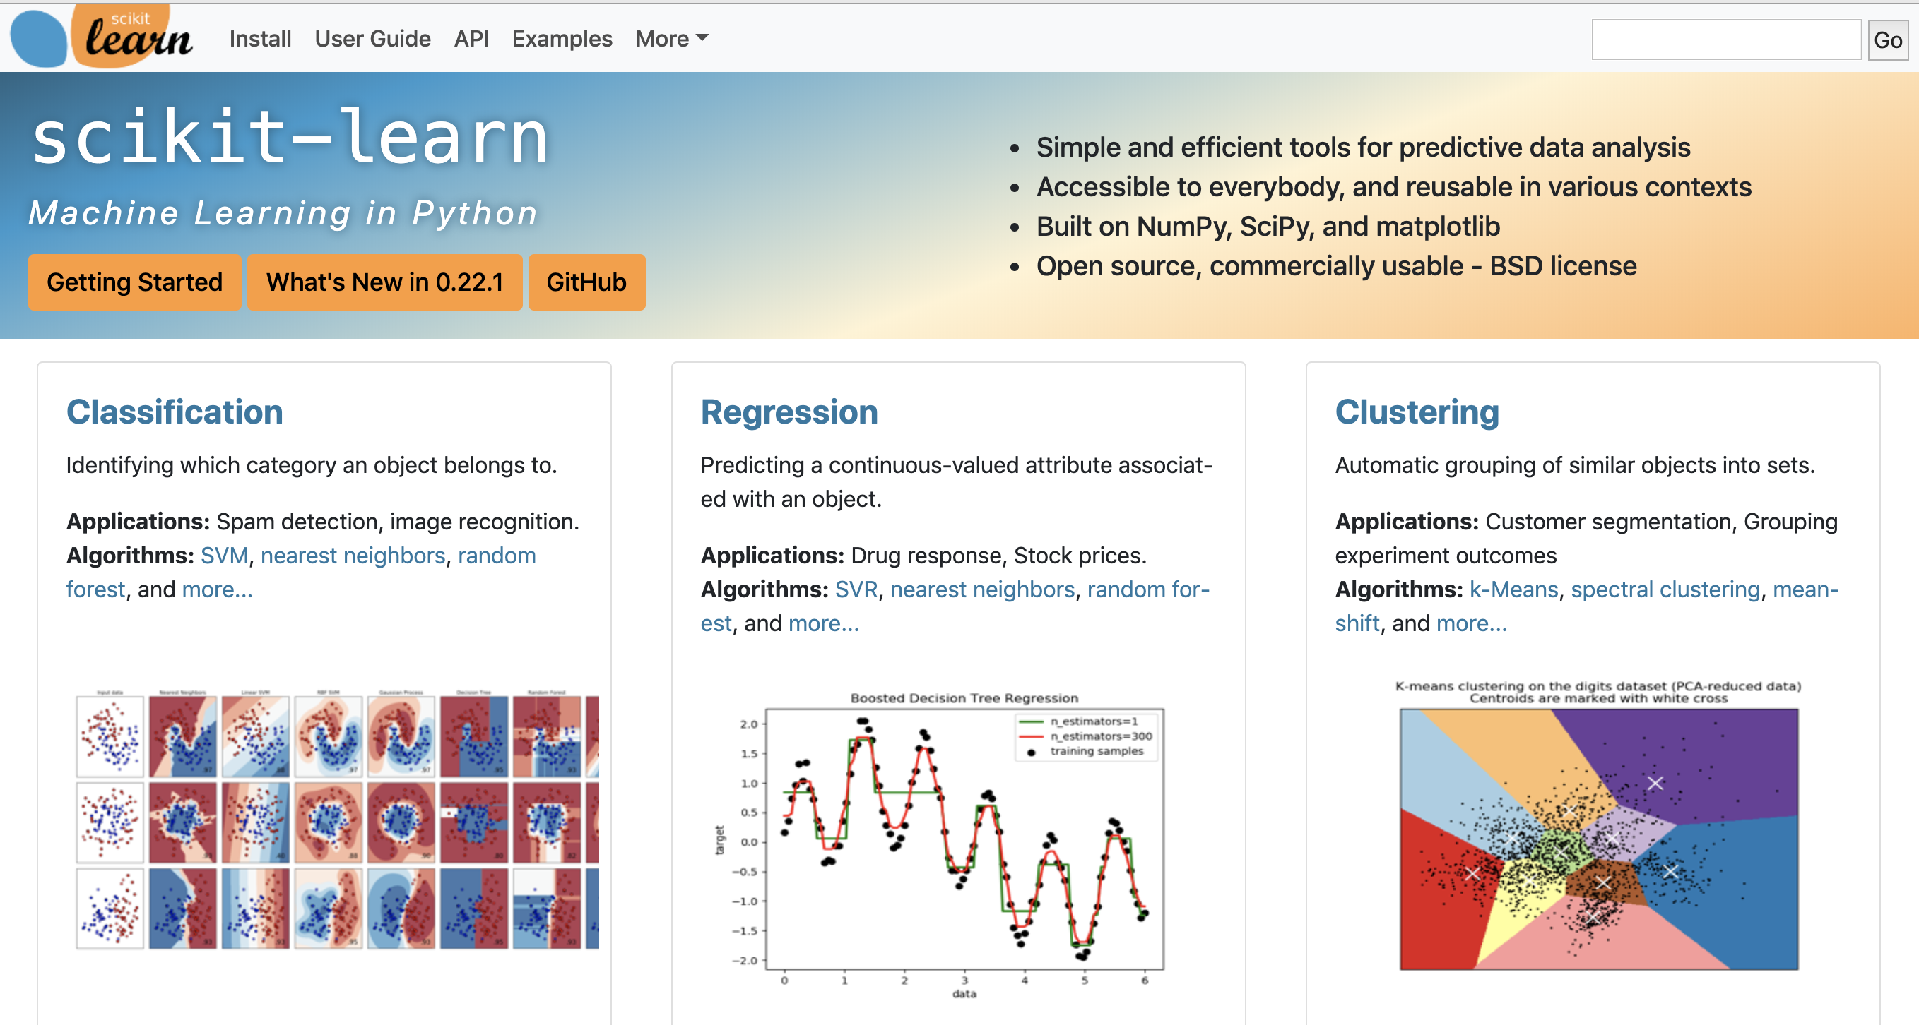
Caret like Python scikit-learn

Slide 33
Partial Model List
Glmnet
K-nearest neighbors
Logistic regression
Neural networks
Random forests
Parallel random forests
Partial Least Squares
Ridge Regression
SVMs
Weighted Least Squares
Extreme Gradient Boosted Trees
Bayesian Additive Regression Trees (BART)
Bayesian GLM
Multivariate Adaptive Regression Splines (MARS)
Partial Least Squares
Least Squares Support Vector Machine with Radial Basis Function Kernel
Fuzzy Rules Using the Structural Learning Algorithm on Vague Environment

Slide 34
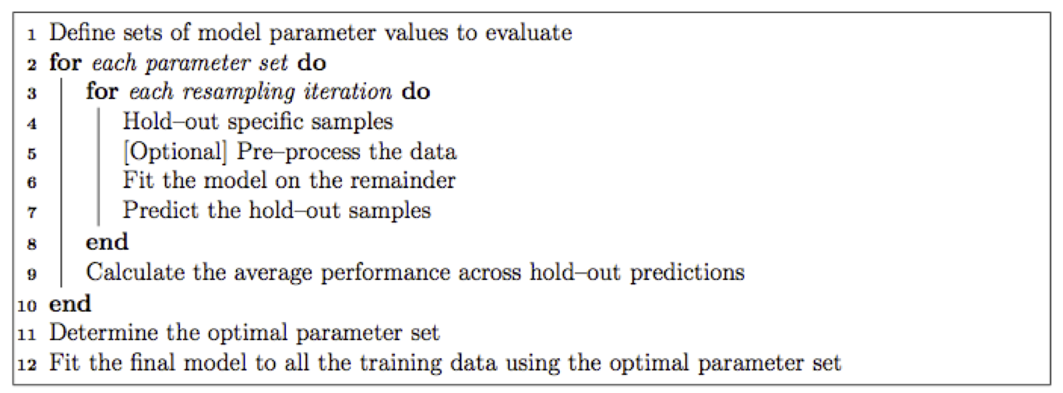
Caret Model Building Process

Slide 35
Key functions: train() and trainControl()
trainControl()
Specifies range of parameters over which you want to estimate your model, nuances of training process
Train()
Function that estimates your model against your data given a formula using options specified by trainControl()

Slide 36
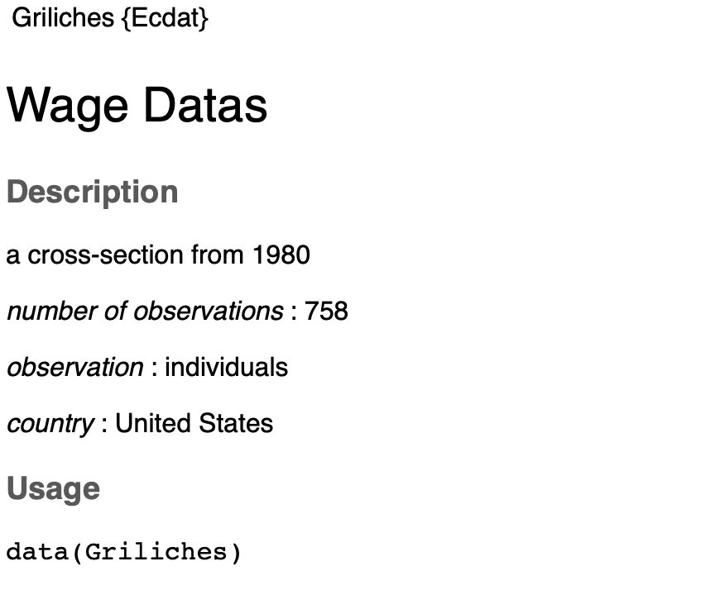
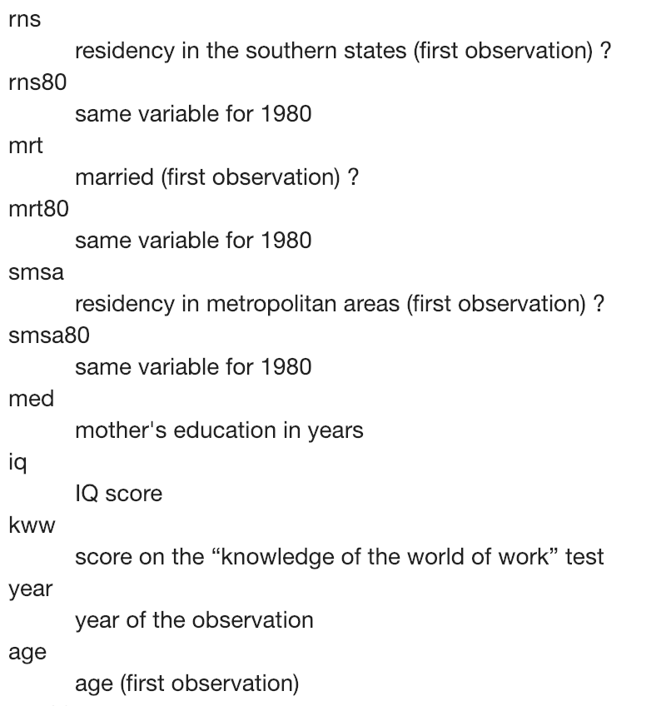
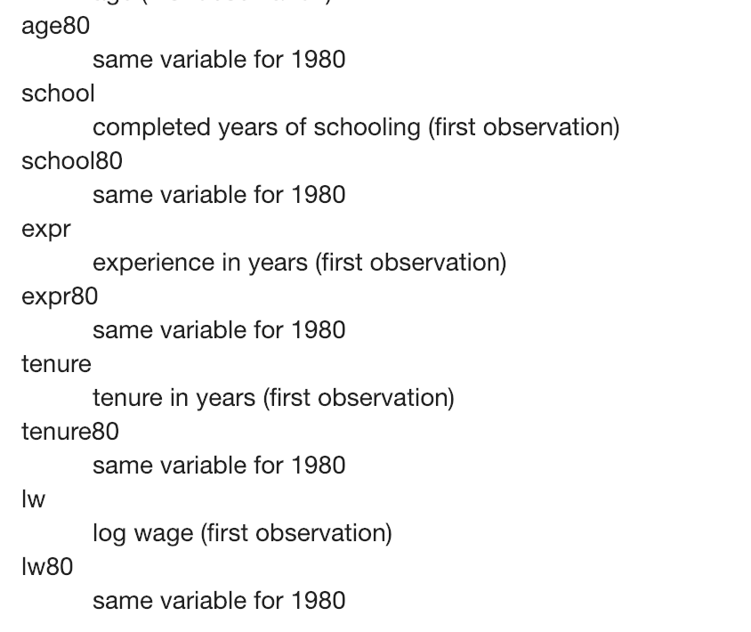
Example Wage Data

Slide 37
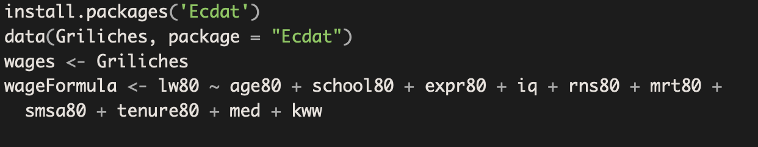
Download Wage DF and create a formula to predict log wage in 1980

Slide 38
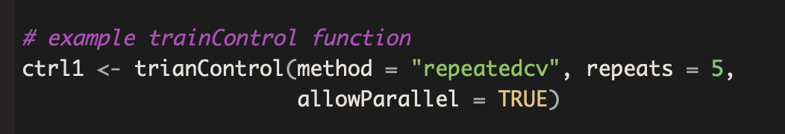
Example trainControl()

Slide 39
Example trainControl()

Slide 40
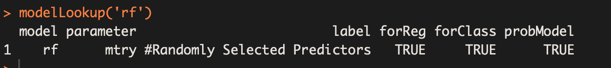
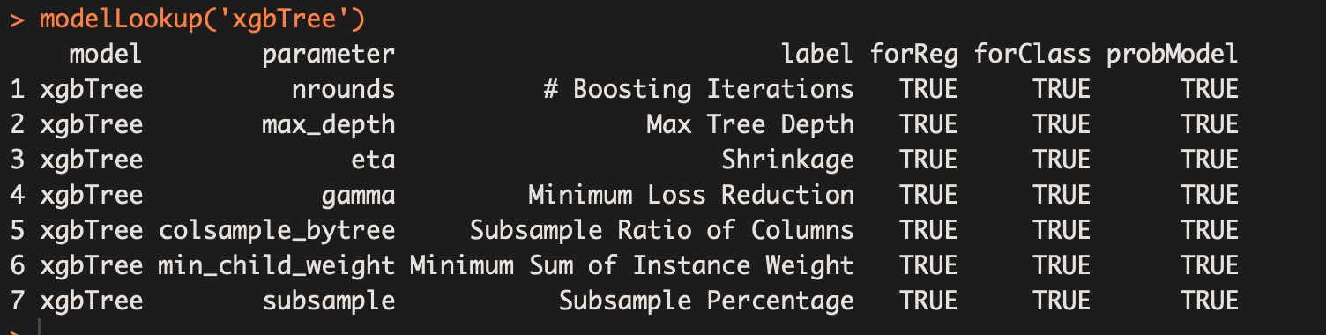
train() function – parameters needed? – modelLookup(‘model’)
See list of models
https://topepo.github.io/caret/available-models.html

Slide 41
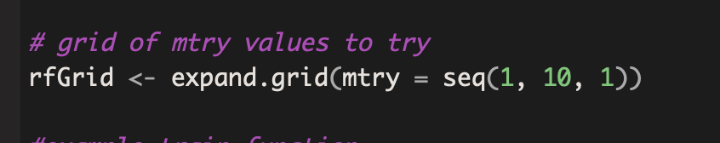
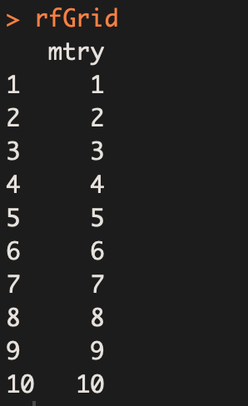
Training Grid

Slide 42
Finally..estimate train() model

Slide 43
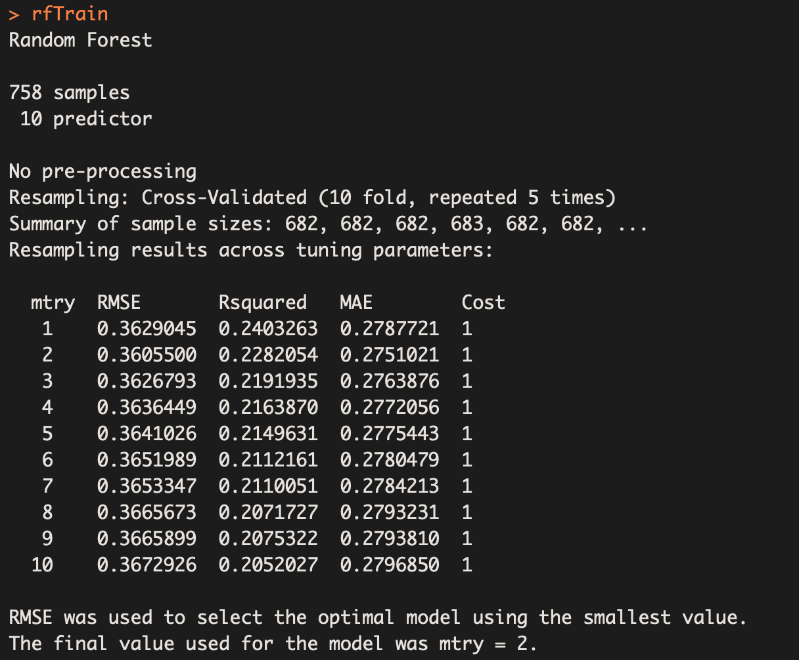

Slide 44
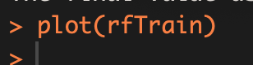

Slide 45
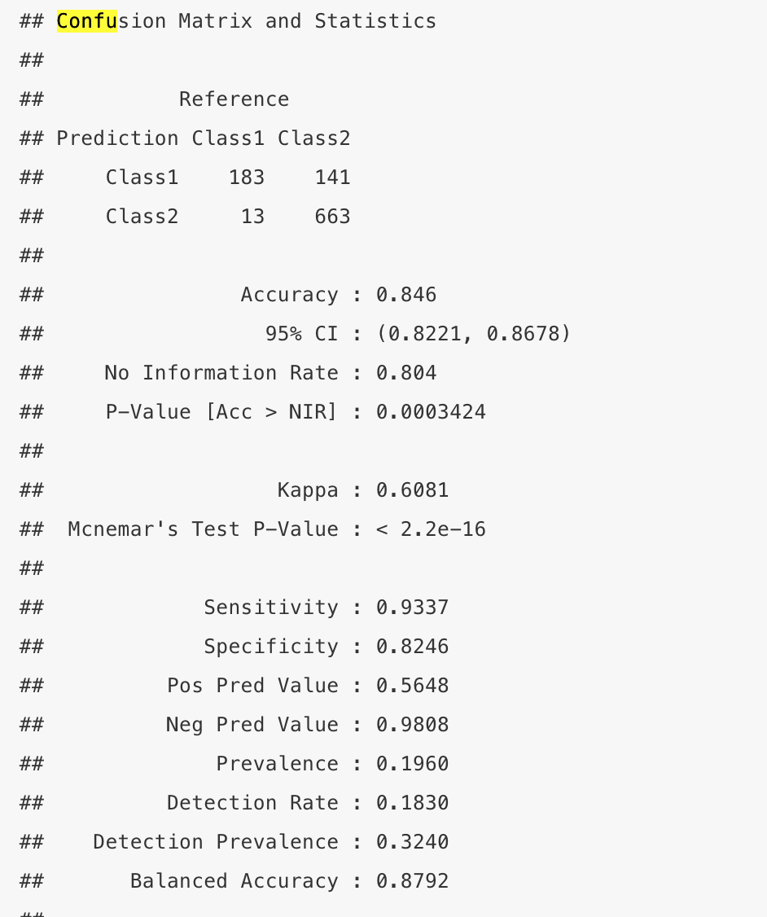
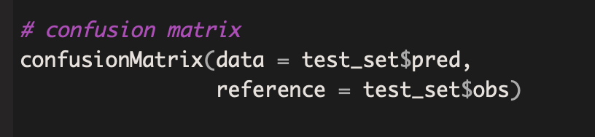
Confusion matrices using confusionMatrix()

Slide 46
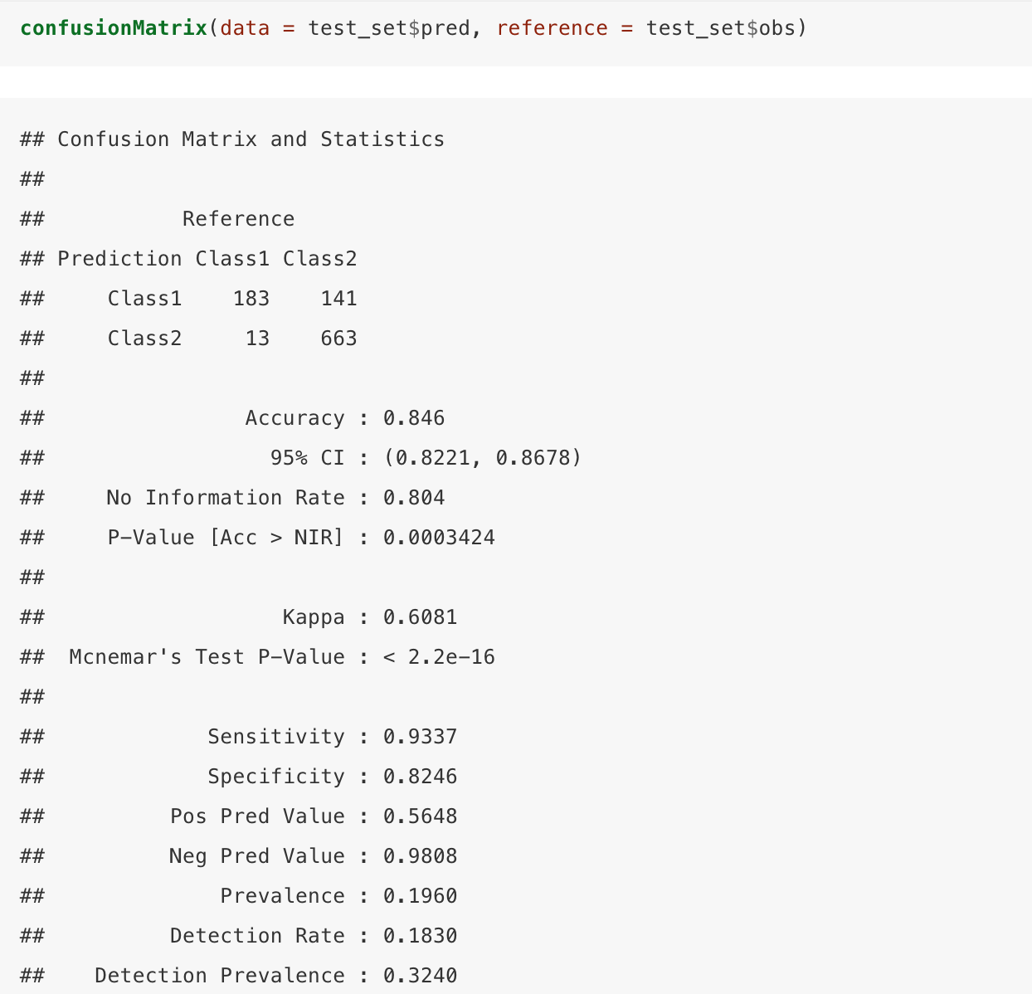

Slide 47
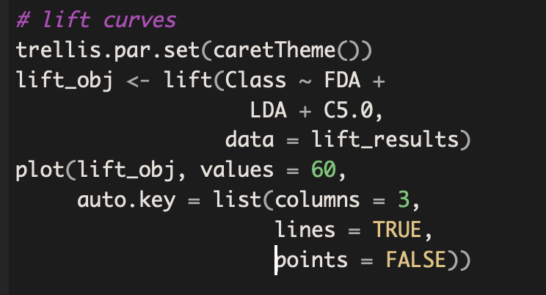
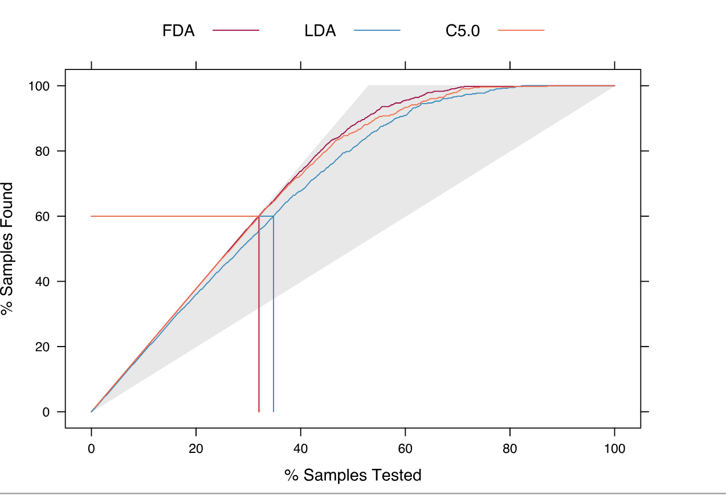
Lift() function for lift curves

Slide 48
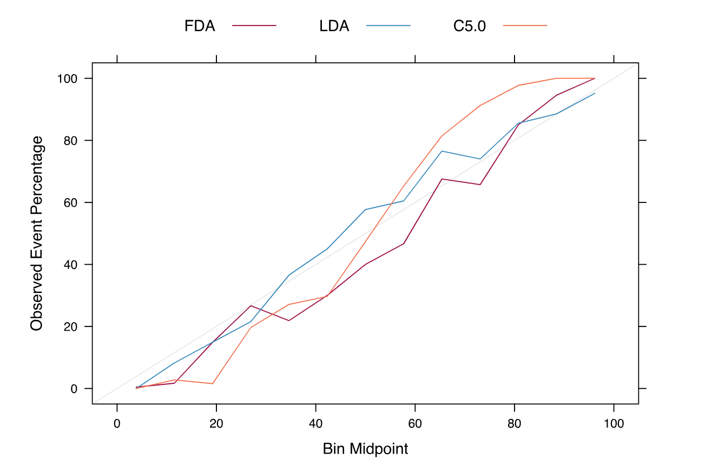
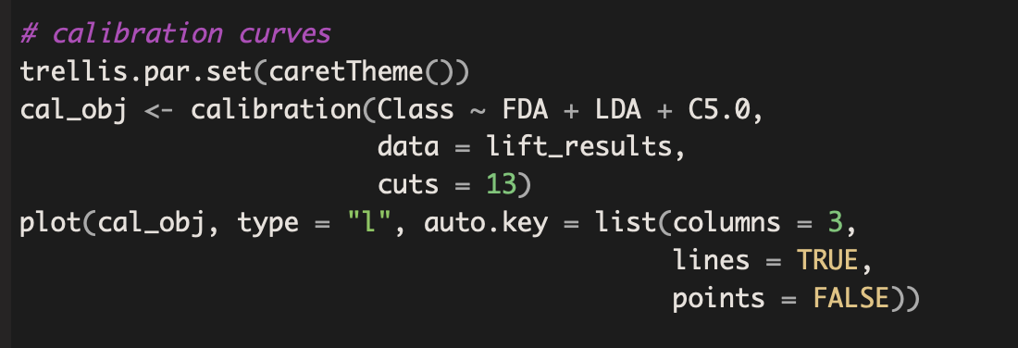
Calibration plots

Slide 49
Okay, your turn
Use the Cracker dataset in the package Ecdat to build an xgboost model using caret to predict purchase of cracker type.
Call modelLookup(“xgbTree”) to intelligently choose your grid of values over which to optimize.
Use “Accuracy” as your metric and plot the results comparing performance across parameter options.

